Slide 1
Discussion 12: ADT's & Sorting
Christine Zhou

Slide 2
Agenda
Announcements
Review sorts and runtimes
Problem 1
Review ADT’s
Problem 2.1

Slide 3
Announcements
Project 2C is due today at 11:59pm!
Apologies for the AG confusion :(
Office hours
We’re sorry OH has been so busy :(
Remember the policies
Midterm 2 grades have been released!
Regrades due this Friday
Let me know if you want to chat!
Only 2 more discussion sections!!
Discussion survey: tinyurl.com/cz-disc12-sp19

Slide 4
Forewarning
Time for a lot of algorithms...

Slide 5
Insertion Sort
Maintain a sorted portion and an unsorted portion
Algorithm: Pick the first element in the unsorted portion and insert it into the correct position in the sorted portion
Keeping swapping the item with whatever is to the left
Will be at the correct position when the left element is less than the element we are inserting
Based on the idea of inversions
Two elements that are out of order (ex. [1, 2, 4, 3] has one inversion between 4 and 3)
Every swap decreases the number of inversions by 1
Runtime: Think about this in terms of inversions
Best: 𝝧(N)
If there are no inversions
Worst:𝝧(N^2)
If there are maximum number of inversions

Slide 6
Selection Sort
Maintain a sorted portion and an unsorted portion
Algorithm: Iterate through the unsorted portion and select the smallest item, bring it to the end of the sorted portion
Runtime:
Best: 𝝧(N^2)
Worst: 𝝧(N^2)

Slide 7
Merge Sort
Split up the work, a single item by itself is inherently sorted
Algorithm:
Split array into two equal partitions
Call mergesort on each of the partitions
Now the partitions are sorted or the partitions are one element
Merge the two partitions together
Have pointers to each partition and combine them so the partitions are now sorted
Runtime:
Best: 𝝧(N log N)
Worst: 𝝧(N log N)

Slide 8
1 Mechanical Sorting
Show the steps taken by each sort on the following unordered list
0, 4, 2, 7, 6, 1, 3, 5
Insertion sort
Selection sort
Merge sort

Slide 9
Q1: Insertion Sort
0 | 4 | 2 | 7 | 6 | 1 | 3 | 5

Slide 10
Q1: Insertion Sort
0 | 4 | 2 | 7 | 6 | 1 | 3 | 5

Slide 11
Q1: Insertion Sort
0 | 4 | 2 | 7 | 6 | 1 | 3 | 5

Slide 12
Q1: Insertion Sort
0 | 2 | 4 | 7 | 6 | 1 | 3 | 5

Slide 13
Q1: Insertion Sort
0 | 2 | 4 | 7 | 6 | 1 | 3 | 5

Slide 14
Q1: Insertion Sort
0 | 2 | 4 | 7 | 6 | 1 | 3 | 5

Slide 15
Q1: Insertion Sort
0 | 2 | 4 | 6 | 7 | 1 | 3 | 5

Slide 16
Q1: Insertion Sort
0 | 2 | 4 | 6 | 7 | 1 | 3 | 5

Slide 17
Q1: Insertion Sort
0 | 2 | 4 | 6 | 1 | 7 | 3 | 5

Slide 18
Q1: Insertion Sort
0 | 2 | 4 | 1 | 6 | 7 | 3 | 5

Slide 19
Q1: Insertion Sort
0 | 2 | 1 | 4 | 6 | 7 | 3 | 5

Slide 20
Q1: Insertion Sort
0 | 1 | 2 | 4 | 6 | 7 | 3 | 5

Slide 21
Q1: Insertion Sort
0 | 1 | 2 | 4 | 6 | 7 | 3 | 5

Slide 22
Q1: Insertion Sort
0 | 1 | 2 | 4 | 6 | 3 | 7 | 5

Slide 23
Q1: Insertion Sort
0 | 1 | 2 | 4 | 3 | 6 | 7 | 5

Slide 24
Q1: Insertion Sort
0 | 1 | 2 | 3 | 4 | 6 | 7 | 5

Slide 25
Q1: Insertion Sort
0 | 1 | 2 | 3 | 4 | 6 | 7 | 5

Slide 26
Q1: Insertion Sort
0 | 1 | 2 | 3 | 4 | 6 | 5 | 7

Slide 27
Q1: Insertion Sort
0 | 1 | 2 | 3 | 4 | 5 | 6 | 7

Slide 28
Q1: Insertion Sort
0 | 1 | 2 | 3 | 4 | 5 | 6 | 7

Slide 29
Q1: Selection Sort
0 | 4 | 2 | 7 | 6 | 1 | 3 | 5
Nothing Smaller than 0!

Slide 30
Q1: Selection Sort
0 | 4 | 2 | 7 | 6 | 1 | 3 | 5
1 is next smallest in the list

Slide 31
Q1: Selection Sort
0 | 1 | 2 | 7 | 6 | 4 | 3 | 5
Swap 1 and 4!

Slide 32
Q1: Selection Sort
0 | 1 | 2 | 7 | 6 | 4 | 3 | 5
Nothing smaller than 2!

Slide 33
Q1: Selection Sort
0 | 1 | 2 | 7 | 6 | 4 | 3 | 5
3 is next smallest in the list!

Slide 34
Q1: Selection Sort
0 | 1 | 2 | 3 | 6 | 4 | 7 | 5
Swap 3 and 7!

Slide 35
Q1: Selection Sort
0 | 1 | 2 | 3 | 6 | 4 | 7 | 5
4 is next smallest in the list!

Slide 36
Q1: Selection Sort
0 | 1 | 2 | 3 | 4 | 6 | 7 | 5
Swap 4 and 6!

Slide 37
Q1: Selection Sort
0 | 1 | 2 | 3 | 4 | 6 | 7 | 5
5 is next smallest in the list!

Slide 38
Q1: Selection Sort
0 | 1 | 2 | 3 | 4 | 5 | 7 | 6
Swap 5 and 6!

Slide 39
Q1: Selection Sort
0 | 1 | 2 | 3 | 4 | 5 | 7 | 6
6 is the next smallest in the list!

Slide 40
Q1: Selection Sort
0 | 1 | 2 | 3 | 4 | 5 | 6 | 7
Swap 6 and 7!

Slide 41
Q1: Selection Sort
0 | 1 | 2 | 3 | 4 | 5 | 6 | 7
Nothing left to see!

Slide 42
Q1: Selection Sort
0 | 1 | 2 | 3 | 4 | 5 | 6 | 7
Done!

Slide 43
Q1: Merge Sort
0 | 4 | 2 | 7 | 6 | 1 | 3 | 5

Slide 44
Q1: Merge Sort
0 | 4 | 2 | 7 | 6 | 1 | 3 | 5
0 | 4 | 2 | 7
6 | 1 | 3 | 5

Slide 45
Q1: Merge Sort
0 | 4 | 2 | 7 | 6 | 1 | 3 | 5
0 | 4 | 2 | 7
6 | 1 | 3 | 5
0 | 4
2 | 7
6 | 1
3 | 5

Slide 46
Q1: Merge Sort
0 | 4 | 2 | 7 | 6 | 1 | 3 | 5
0 | 4 | 2 | 7
6 | 1 | 3 | 5
0 | 4
2 | 7
6 | 1
3 | 5
0
4
2
7
6
1
3
5

Slide 47
Q1: Merge Sort
0 | 4 | 2 | 7 | 6 | 1 | 3 | 5
0 | 4 | 2 | 7
6 | 1 | 3 | 5
0 | 4
2 | 7
6 | 1
3 | 5
0
4
2
7
6
1
3
5
0 | 4
2 | 7
1 | 6
3 | 5

Slide 48
Q1: Merge Sort
0 | 4 | 2 | 7 | 6 | 1 | 3 | 5
0 | 4 | 2 | 7
6 | 1 | 3 | 5
0 | 4
2 | 7
6 | 1
3 | 5
0
4
2
7
6
1
3
5
0 | 4
2 | 7
1 | 6
3 | 5
0 | 2 | 4 | 7
1 | 3 | 5 | 6

Slide 49
Q1: Merge Sort
0 | 4 | 2 | 7 | 6 | 1 | 3 | 5
0 | 4 | 2 | 7
6 | 1 | 3 | 5
0 | 4
2 | 7
6 | 1
3 | 5
0
4
2
7
6
1
3
5
0 | 4
2 | 7
1 | 6
3 | 5
0 | 2 | 4 | 7
1 | 3 | 5 | 6
0

Slide 50
Q1: Merge Sort
0 | 4 | 2 | 7 | 6 | 1 | 3 | 5
0 | 4 | 2 | 7
6 | 1 | 3 | 5
0 | 4
2 | 7
6 | 1
3 | 5
0
4
2
7
6
1
3
5
0 | 4
2 | 7
1 | 6
3 | 5
0 | 2 | 4 | 7
1 | 3 | 5 | 6
0 | 1

Slide 51
Q1: Merge Sort
0 | 4 | 2 | 7 | 6 | 1 | 3 | 5
0 | 4 | 2 | 7
6 | 1 | 3 | 5
0 | 4
2 | 7
6 | 1
3 | 5
0
4
2
7
6
1
3
5
0 | 4
2 | 7
1 | 6
3 | 5
0 | 2 | 4 | 7
1 | 3 | 5 | 6
0 | 1 | 2

Slide 52
Q1: Merge Sort
0 | 4 | 2 | 7 | 6 | 1 | 3 | 5
0 | 4 | 2 | 7
6 | 1 | 3 | 5
0 | 4
2 | 7
6 | 1
3 | 5
0
4
2
7
6
1
3
5
0 | 4
2 | 7
1 | 6
3 | 5
0 | 2 | 4 | 7
1 | 3 | 5 | 6
0 | 1 | 2 | 3

Slide 53
Q1: Merge Sort
0 | 4 | 2 | 7 | 6 | 1 | 3 | 5
0 | 4 | 2 | 7
6 | 1 | 3 | 5
0 | 4
2 | 7
6 | 1
3 | 5
0
4
2
7
6
1
3
5
0 | 4
2 | 7
1 | 6
3 | 5
0 | 2 | 4 | 7
1 | 3 | 5 | 6
0 | 1 | 2 | 3 | 4

Slide 54
Q1: Merge Sort
0 | 4 | 2 | 7 | 6 | 1 | 3 | 5
0 | 4 | 2 | 7
6 | 1 | 3 | 5
0 | 4
2 | 7
6 | 1
3 | 5
0
4
2
7
6
1
3
5
0 | 4
2 | 7
1 | 6
3 | 5
0 | 2 | 4 | 7
1 | 3 | 5 | 6
0 | 1 | 2 | 3 | 4 | 5

Slide 55
Q1: Merge Sort
0 | 4 | 2 | 7 | 6 | 1 | 3 | 5
0 | 4 | 2 | 7
6 | 1 | 3 | 5
0 | 4
2 | 7
6 | 1
3 | 5
0
4
2
7
6
1
3
5
0 | 4
2 | 7
1 | 6
3 | 5
0 | 2 | 4 | 7
1 | 3 | 5 | 6
0 | 1 | 2 | 3 | 4 | 5 | 6

Slide 56
Q1: Merge Sort
0 | 4 | 2 | 7 | 6 | 1 | 3 | 5
0 | 4 | 2 | 7
6 | 1 | 3 | 5
0 | 4
2 | 7
6 | 1
3 | 5
0
4
2
7
6
1
3
5
0 | 4
2 | 7
1 | 6
3 | 5
0 | 2 | 4 | 7
1 | 3 | 5 | 6
0 | 1 | 2 | 3 | 4 | 5 | 6 | 7

Slide 57
Q1: Merge Sort
0 | 4 | 2 | 7 | 6 | 1 | 3 | 5
0 | 4 | 2 | 7
6 | 1 | 3 | 5
0 | 4
2 | 7
6 | 1
3 | 5
0
4
2
7
6
1
3
5
0 | 4
2 | 7
1 | 6
3 | 5
0 | 2 | 4 | 7
1 | 3 | 5 | 6
0 | 1 | 2 | 3 | 4 | 5 | 6 | 7
Notes:
Note: You should explain that merging process that happened at the bottom layer, happens at each sorting stage. For space purposes, just shown at the last merge operation

Slide 58
Heapsort
Idea: Use a heap to help sort
Let’s use a max heap for now
Algorithm:
Turn the array into a max heap
Repeat until heap is empty
Remove max from the heap, rearrange the array, put element in the freed spot
How do we turn the array into a max heap?
Iterate through the elements in the array and add to a max heap (𝝧(N log N))
Bottom-up heapification (𝝧(N)) ← this is better!
Runtime:
Best: 𝝧(N)
All elements are the same, no bubbling needed after a removal
Worst: 𝝧(N log N)

Slide 59
Heapsort (continued)
What if we use a min heap?
Every removal will return the smallest element instead, but the empty spot will still appear at the end
Will need an auxiliary array to store elements or will need to shift all the items over if we want to use the same array

Slide 60
Q1 Heapsort
0
6
2
7
4
0 | 6 | 2 | 7 | 4

Slide 61
Q1 Heapsort
Heapify!
7
6
2
0
4
7 | 6 | 2 | 0 | 4

Slide 62
Q1 Heapsort
Pop max, and insert at end!
4
6
2
0
4 | 6 | 2 | 0 | 7

Slide 63
Q1 Heapsort
Heapify!
6
4
2
0
6 | 4 | 2 | 0 | 7

Slide 64
Q1 Heapsort
Pop max, and insert at end!
0
4
2
0 | 4 | 2 | 6 | 7

Slide 65
Q1 Heapsort
Heapify!
4
0
2
4 | 0 | 2 | 6 | 7

Slide 66
Q1 Heapsort
Pop max, and insert at end!
2
0
2 | 0 | 4 | 6 | 7

Slide 67
Q1 Heapsort
Heapify!
2
0
2 | 0 | 4 | 6 | 7

Slide 68
Q1 Heapsort
Pop max, and insert at end!
0
0 | 2 | 4 | 6 | 7

Slide 69
Q1 Heapsort
Heapify!
0
0 | 2 | 4 | 6 | 7

Slide 70
Q1 Heapsort
Pop max, and insert at end!
Done
0 | 2 | 4 | 6 | 7

Slide 71
Abstract Data Types (ADT’s)
ADT’s are an “idea” that describe a particular behavior, but don’t describe how this behavior will be implemented
ADT’s are usually shown with an interface
ADT’s are implemented with data structures
Example 1
ADT: Map, keep a mapping between keys and values
DS: trees to create TreeMap, hashing + arrays to create HashMap
Example 2
ADT: PriorityQueue, order elements based on a priority
DS: linked list, balanced binary search tree, binary heap

Slide 72
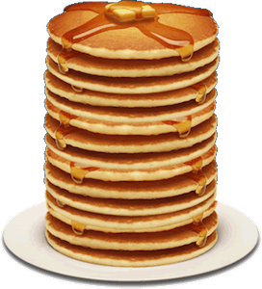
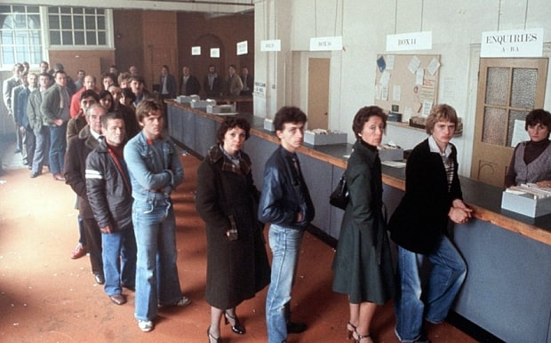
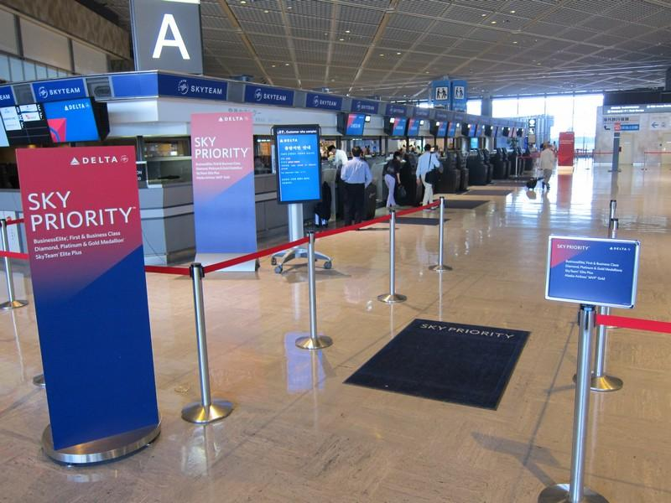
ADT’s and Defining Behavior
ADT | List | Set | Map | Stack | Queue | Priority Queue
Defining Behavior | Order of a collection or sequence of elements | (unordered) collection of unique elements | Collection of key-value mappings | Linear collection with LIFO removal | Linear collection with FIFO removal | Linear collection with priority removal

Slide 73
Choosing the Best ADT
What behaviors do you care about?
maintaining order, checking membership, FIFO, LIFO, etc
What ADTs match this behavior?
We don’t care about implementation yet! Just behavior, that’s why we are only thinking about ADTs right now
Once you figure out the ADT works best, start thinking about the best implementation of the ADT which works for your needs
Think about space and runtime requirements here
E.g. You know a Set (ADT) meets your behavior requirements, now does a HashSet (DS) or TreeSet (DS) meet your runtime/space requirements better?

Slide 74
2 Abstract Data Types
For each problem, which of the ADT’s given in the previous section might you use to solve each problem? Which ones will make for a better or more efficient implementation?
a) Given a news article, find the frequency of each word used in the article
Map. Maintain mapping between word and count.

Slide 75
2 Abstract Data Types
For each problem, which of the ADT’s given in the previous section might you use to solve each problem? Which ones will make for a better or more efficient implementation?
b) Given an unsorted array of integers, return the array sorted from least to greatest.
Priority Queue. Insert numbers with priority equal to their value. Then remove min and insert into an array.

Slide 76
2 Abstract Data Types
For each problem, which of the ADT’s given in the previous section might you use to solve each problem? Which ones will make for a better or more efficient implementation?
c) Implement the forward and back buttons for a web browser.
Two stacks; one for each button.
Going to a new page: add new page to the back button stack
Pressing back button: add current page to forward button stack, remove from back button stack
Pressing forward button: add current page to back button stack, remove from forward button stack

Slide 77
2 Abstract Data Types
Define a Queue class that implements the offer and poll methods of a queue ADT using only a Stack class which implements the stack ADT.
Hint: Consider using two stacks.
Queue
poll(): removes and returns front element of queue
offer(element): adds element to back of queue

Slide 78
Q2.2 Visual
q.offer(5)
ADT: Queue
Implementation: 2 Stacks
5
Stack

Slide 79
Q2.2 Visual
q.offer(7)
ADT: Queue
Implementation: 2 Stacks
7
5
Stack

Slide 80
Q2.2 Visual
q.offer(9)
ADT: Queue
Implementation: 2 Stacks
9
7
5
Stack

Slide 81
Q2.2 Visual
q.poll()
ADT: Queue
Pop from stack and push onto temp! Bottom of stack goes to the top of temp, now we can mimic FIFO
Implementation: 2 Stacks
9
7
5
Stack
temp

Slide 82
Q2.2 Visual
q.poll()
ADT: Queue
Pop from stack and push onto temp! Bottom of stack goes to the top of temp, now we can mimic FIFO
Implementation: 2 Stacks
7
5
9
Stack
temp

Slide 83
Q2.2 Visual
q.poll()
ADT: Queue
Pop from stack and push onto temp! Bottom of stack goes to the top of temp, now we can mimic FIFO
Implementation: 2 Stacks
7
5
9
Stack
temp

Slide 84
Q2.2 Visual
q.poll()
ADT: Queue
Pop from stack and push onto temp! Bottom of stack goes to the top of temp, now we can mimic FIFO
Implementation: 2 Stacks
5
7
9
Stack
temp

Slide 85
Q2.2 Visual
q.poll()
ADT: Queue
Pop from temp to get the first element in the stack and save it
Toret: 5
Implementation: 2 Stacks
7
9
Stack
temp

Slide 86
Q2.2 Visual
q.poll()
ADT: Queue
Push everything back onto stack so it’s back to its original state next time we call offer or poll
Toret: 5
Implementation: 2 Stacks
7
9
Stack
temp

Slide 87
Q2.2 Visual
q.poll()
ADT: Queue
Push everything back onto stack so it’s back to its original state next time we call offer or poll
Toret: 5
Implementation: 2 Stacks
9
7
Stack
temp

Slide 88
Q2.2 Visual
q.poll()
ADT: Queue
Return toret!
Toret: 5
Implementation: 2 Stacks
9
7
Stack
temp

Slide 89
Q2.2 Visual
ADT: Queue
Exit method
Implementation: 2 Stacks
9
7
Stack

Slide 90
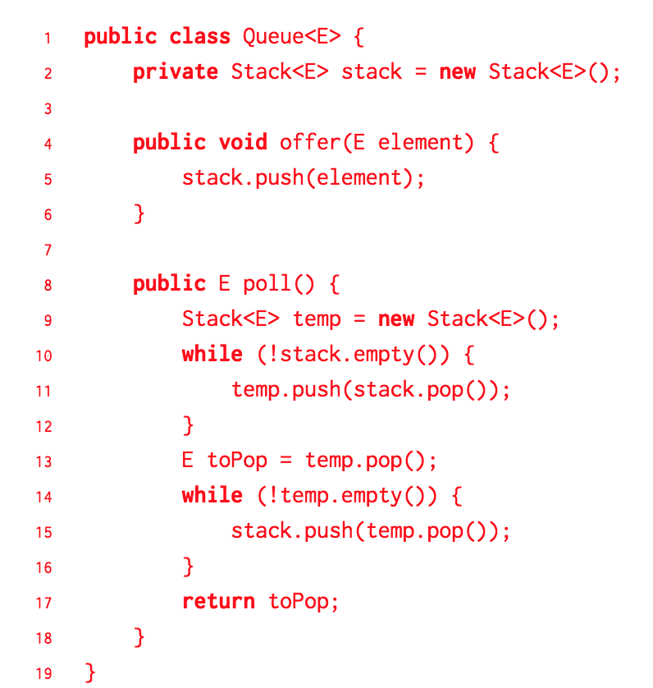
Q2.2 Answer

